Slide 2
THE WORLD’S LEADING PLATFORM FOR MODERN ASSISTIVE TECHNOLOGY
OTWorld 2026 combines a high-caliber world congress with the world's leading international trade fair and sets new standards for modern assistive technology.
20,400 trade visitors from 96 countries
over 570 international exhibitors
over 300 international speakers
2,550 congress participants

Slide 3
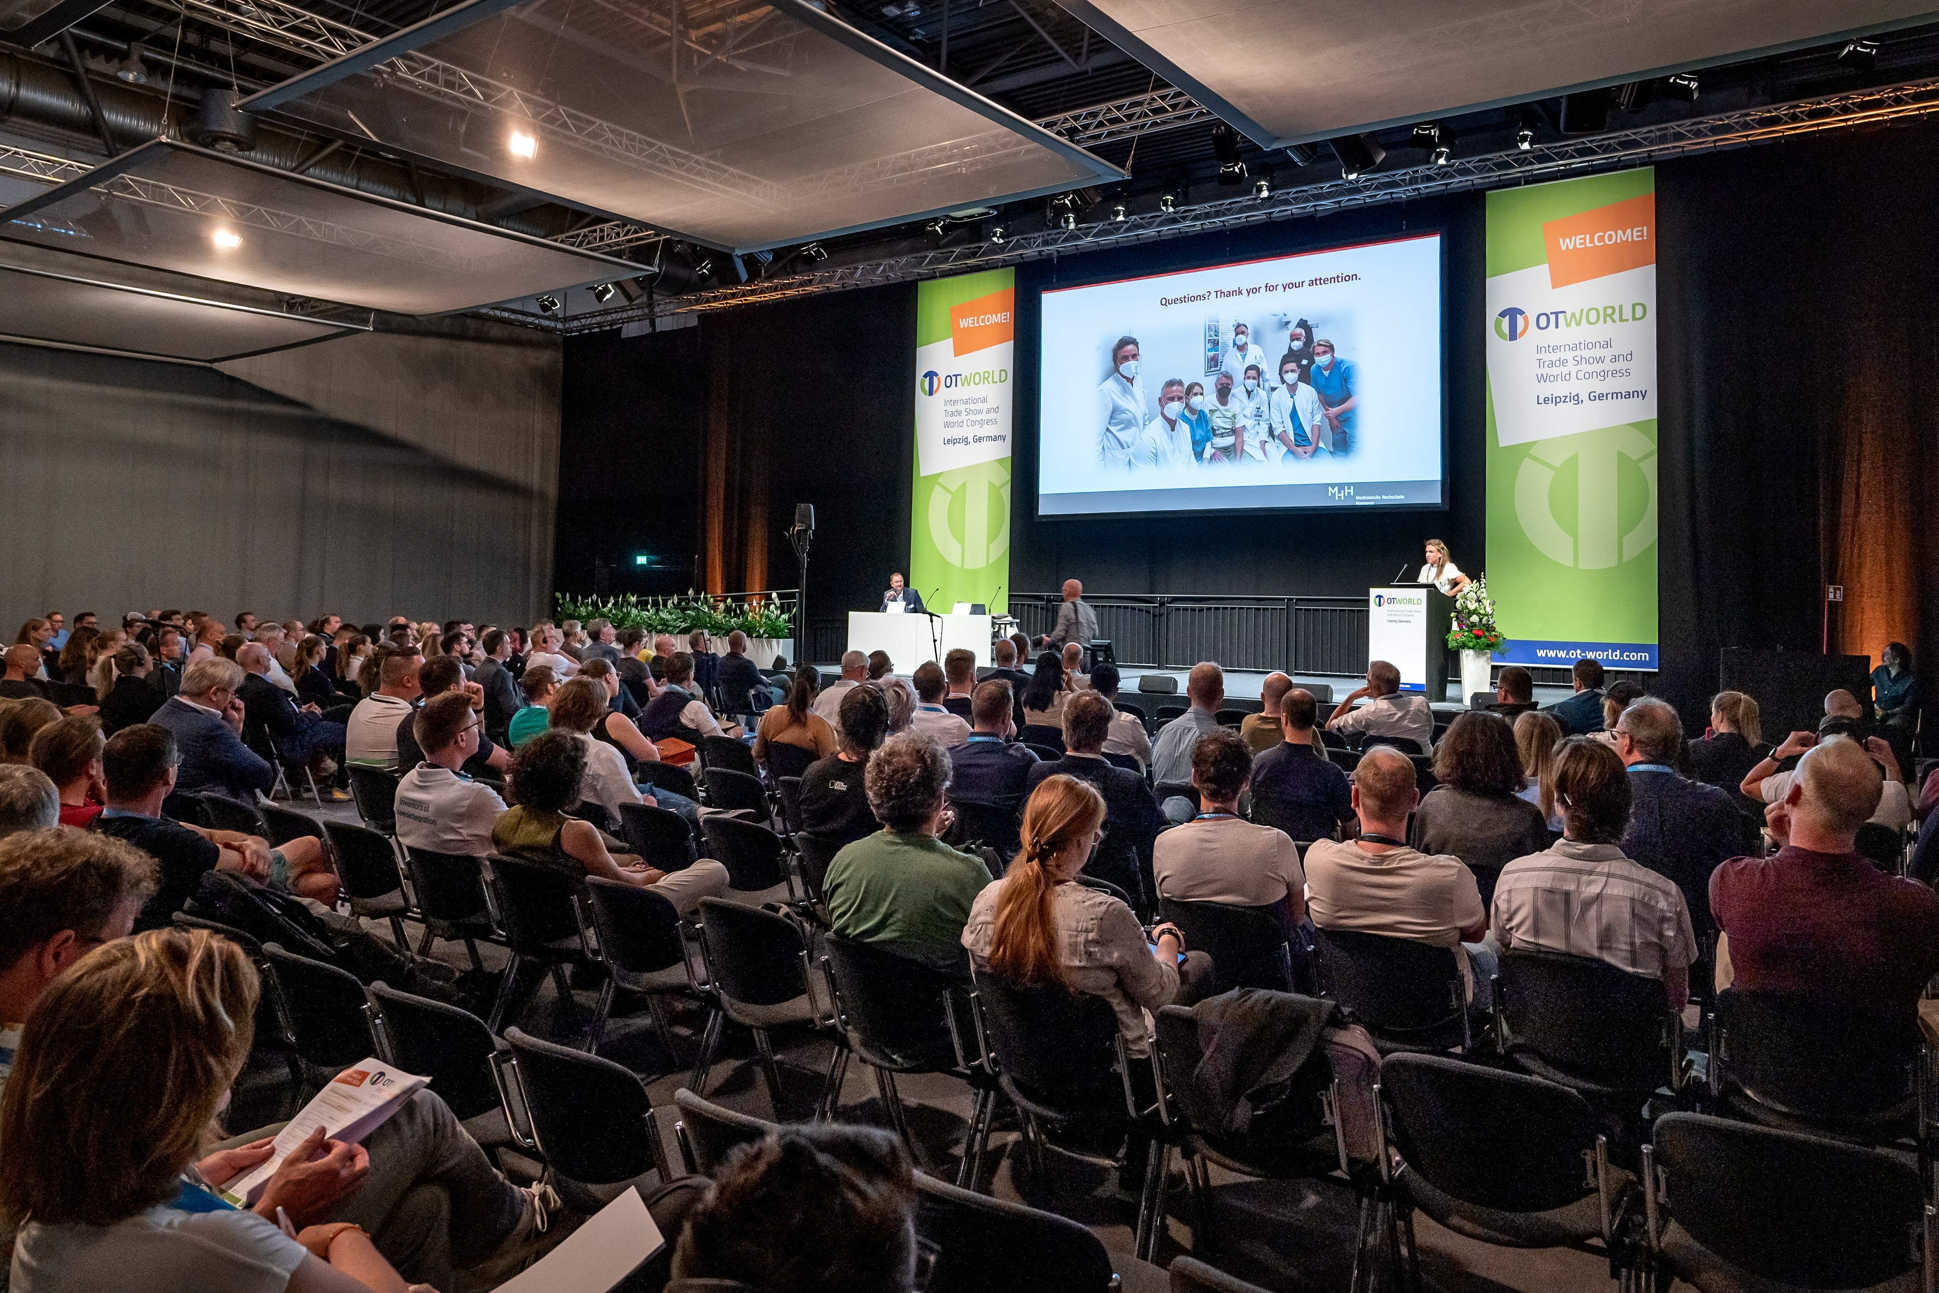
THE World Congress
Prosthetics, Orthotics
Orthopaedic footwear technology
Rehabilitation technology, rehabilitation
Pediatric/adolescent and neuro-orthopedics
Biomechanics
Materials research, production technology
Digitalisation
Sports orthopaedics / parasport
Physiotherapy
Age-appropriate assistance systems
Learning systems, robotics
Conference languages: German & English – with AI-supported translation into the other language.

Slide 4
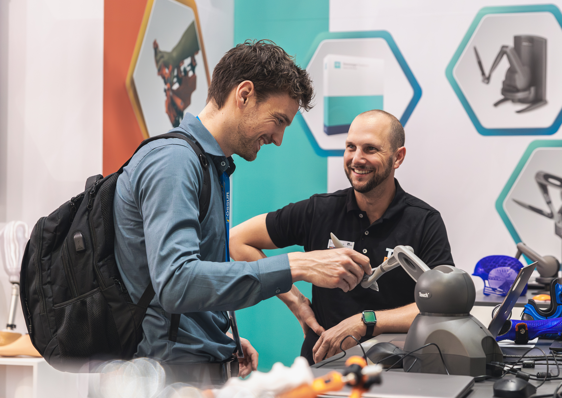
THE International Trade Fair
Global market overview in prosthetics, orthotics, orthopedic footwear technology, rehab technology, rehabilitation and compression therapy
Concepts and aids in 9 treatment areas (mobility limitations, diabetes & vascular diseases, stroke, back problems, cancer, sports injuries, prevention, etc.)

Slide 5
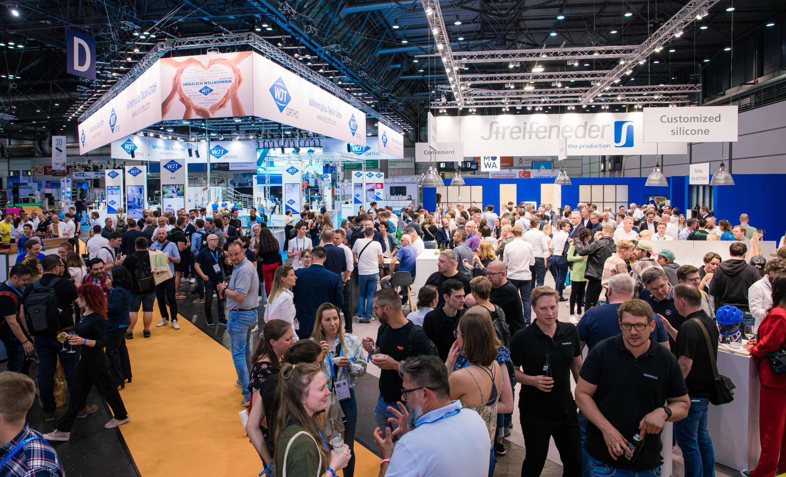
OTWorld 2026 – Get your ticket now
You make the difference!
Expand your knowledge and gain practical inspiration at the world's leading trade fair and world congress. Secure your ticket by March 31, 2026 and benefit from the early bird discount.
The ticket shop will open in January.

Slide 6

We look forward to seeing you!
We are part of OTWorld.friends, a network of associations and professional societies around the world that support the transfer of knowledge at OTWorld.
We look forward to seeing you in Leipzig, Germany
from May 19 to 22!

